Slide 1


Unit 5
Support for quality
Notes:
Welcome to Unit 5 of Module 5.

Slide 2
By the end of this unit, you will be able to:
assess and record data related to support for quality at various service sites within a health facility​
Notes:
By the end of this unit, you will be able to correctly assess and record data related to support for quality at various service sites within a health facility.

Slide 3


Support for quality: Guidelines and job aids
Throughout the questionnaire, there are questions related to the availability of documents:
guidelines
job aids
It is important to understand the difference between these two types of documents, because this information needs to be collected through observation.
Notes:
Throughout the questionnaire, in the category “support for quality”, there are questions related to the availability of documents – mainly guidelines and job aids.
It is important to understand the difference between these two types of documents, and between these two types and patient health education materials, because this information needs to be collected through observation.

Slide 4
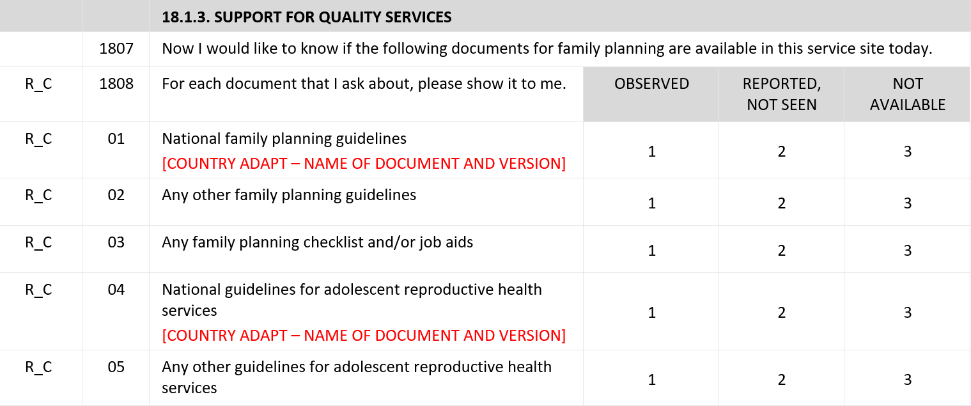
Support for quality: Guidelines and job aids
Notes:
The response options for availability of guidelines and job aids are the same as for infection prevention and control items:
“OBSERVED”;
“REPORTED, NOT SEEN”;
“NOT AVAILABLE”.

Slide 5

Support for quality: Guidelines
National guidelines are usually:
comprehensive
presented in a bound booklet
It is acceptable if numerous topics are covered in the same guideline.
Notes:
National Guidelines are usually comprehensive. They are frequently presented in a bound booklet.
For some services, guidelines or protocols for specific topics are asked about, and it is acceptable if numerous topics are covered in the same guideline.

Slide 6
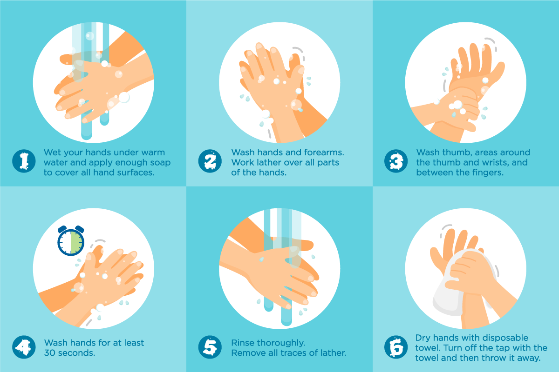
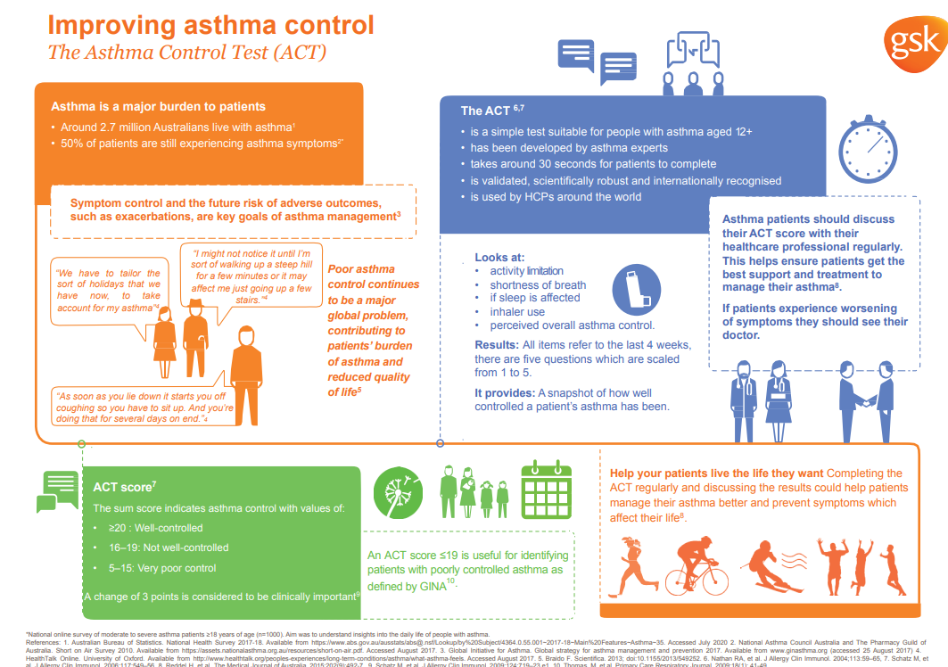
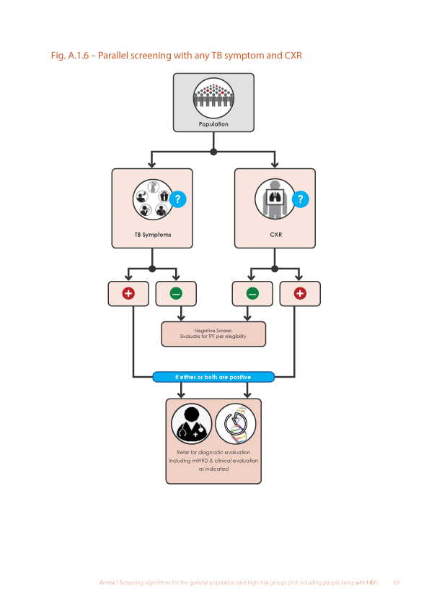
Support for quality: Job aids
Job aids help health workers to follow standards and guidelines.
posters
checklists
booklets, pamphlets
charts
Notes:
Job aids help health workers to follow standards and guidelines. They may be presented in:
posters;
checklists;
booklets;
pamphlets; or
charts.

Slide 7
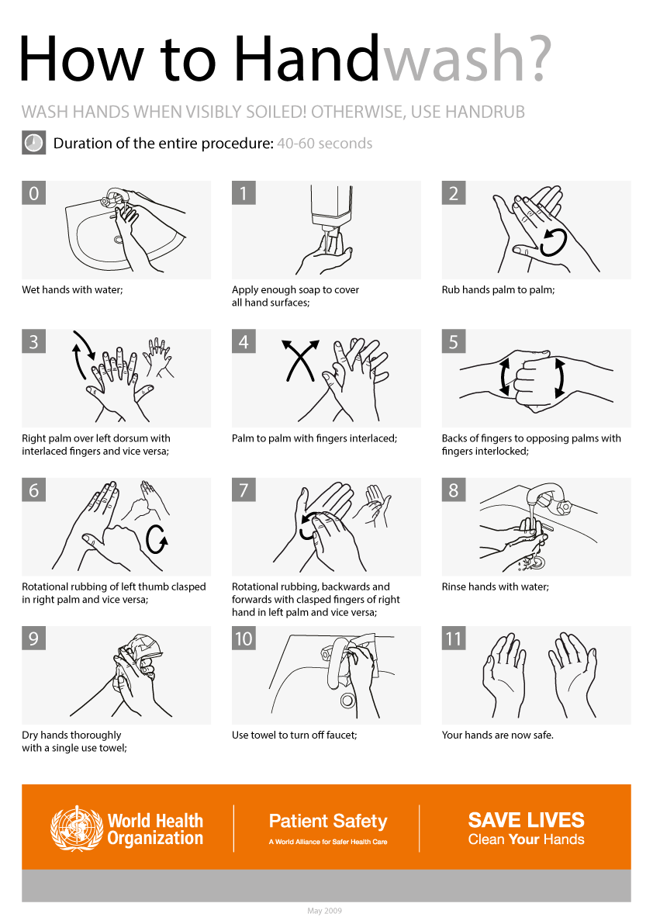
Support for quality: Job aids
A job aid could be a poster for handwashing:
Notes:
So, for example, a job aid could be a poster for hand washing, or decontaminating equipment, or some other aspect of standard precautions;

Slide 8
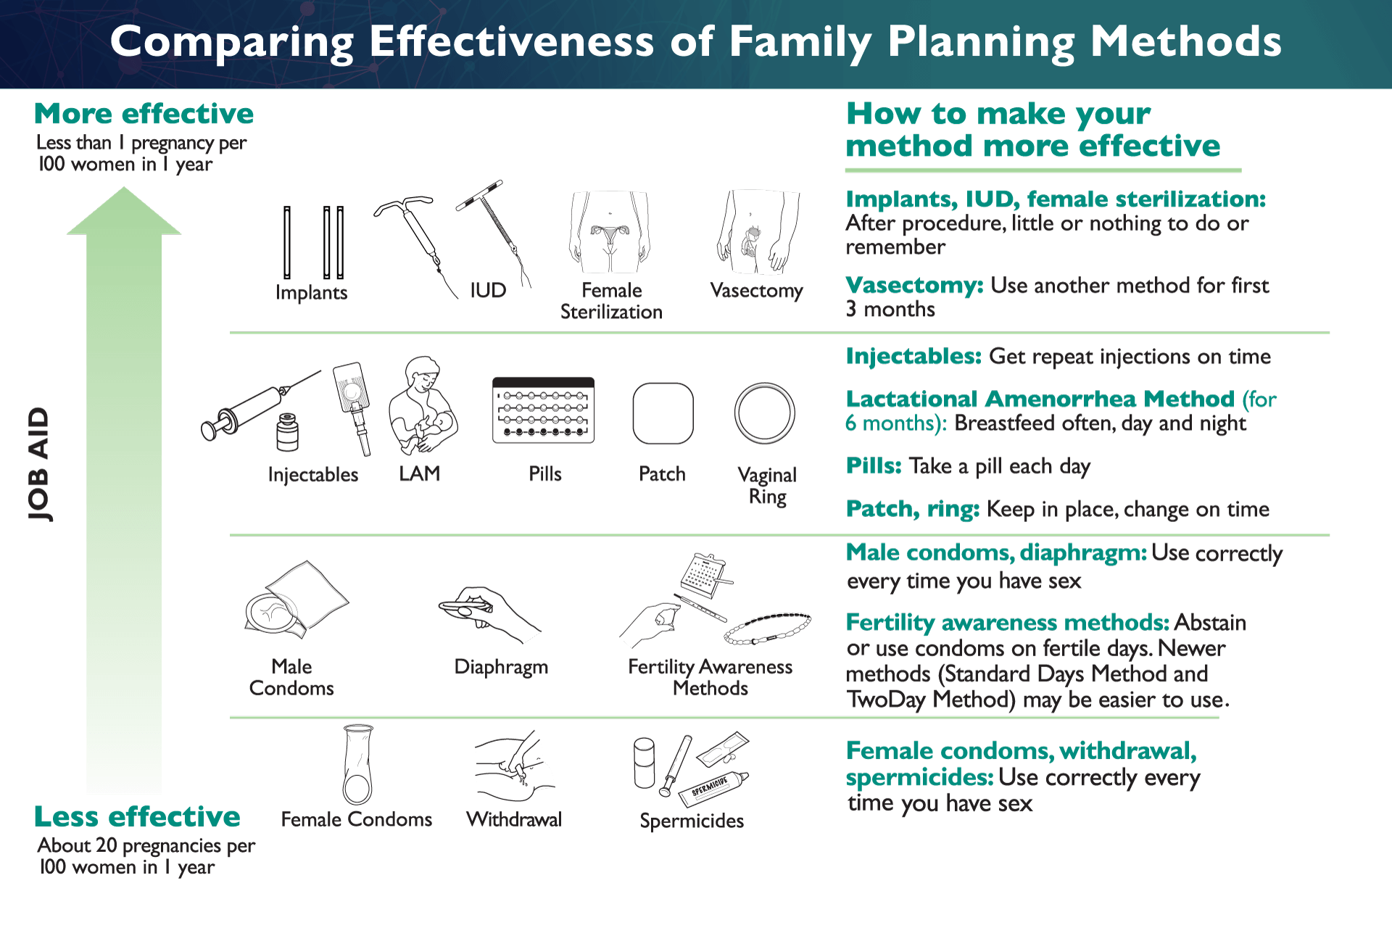
Support for quality: Job aids
A job aid could be a poster for family planning:
Notes:
or a poster that describes the different family planning methods and how to help clients make their method more effective.

Slide 9
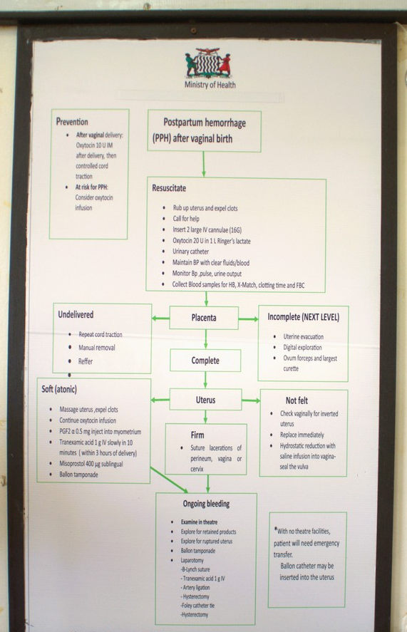
Support for quality: Guidelines and job aids
An item can be both a guideline and a job aid.
Example
This poster for how to manage postpartum haemorrhage may be:
a guideline for managing postpartum haemorrhage
a job aid for National Delivery Guidelines
© WHO / Yolanda Barber
Notes:
Sometimes an item can be both a guideline and a job aid, depending on how the questionnaire asks for it.
For example, National Delivery Guidelines would usually cover many different procedures and steps in the care process during labour, delivery, and postpartum.
This poster for how to manage postpartum haemorrhage may be:
a guideline for managing postpartum haemorrhage; or
a job aid for National Delivery Guidelines.

Slide 10
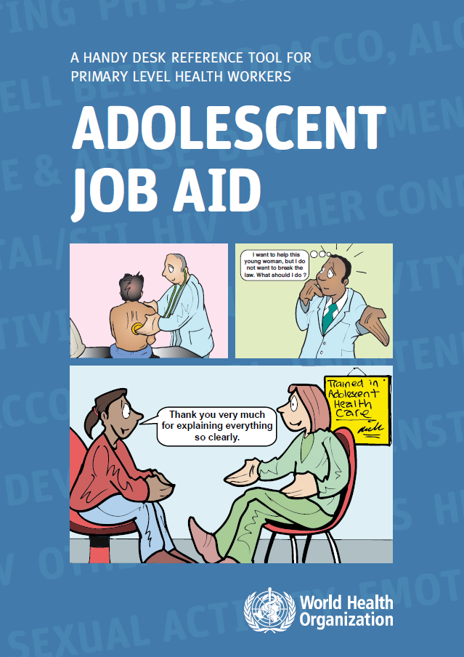
Support for quality: Guidelines and job aids
Is an item a guideline or job aid?
Guideline: covers a topic fully
Job aid:
only covers part of a topic
Notes:
When deciding if an item is a guideline or a job aid, you must assess whether:
the item fully covers the topic being asked about (a guideline); or
only covers a part of it (a job aid).

Slide 11
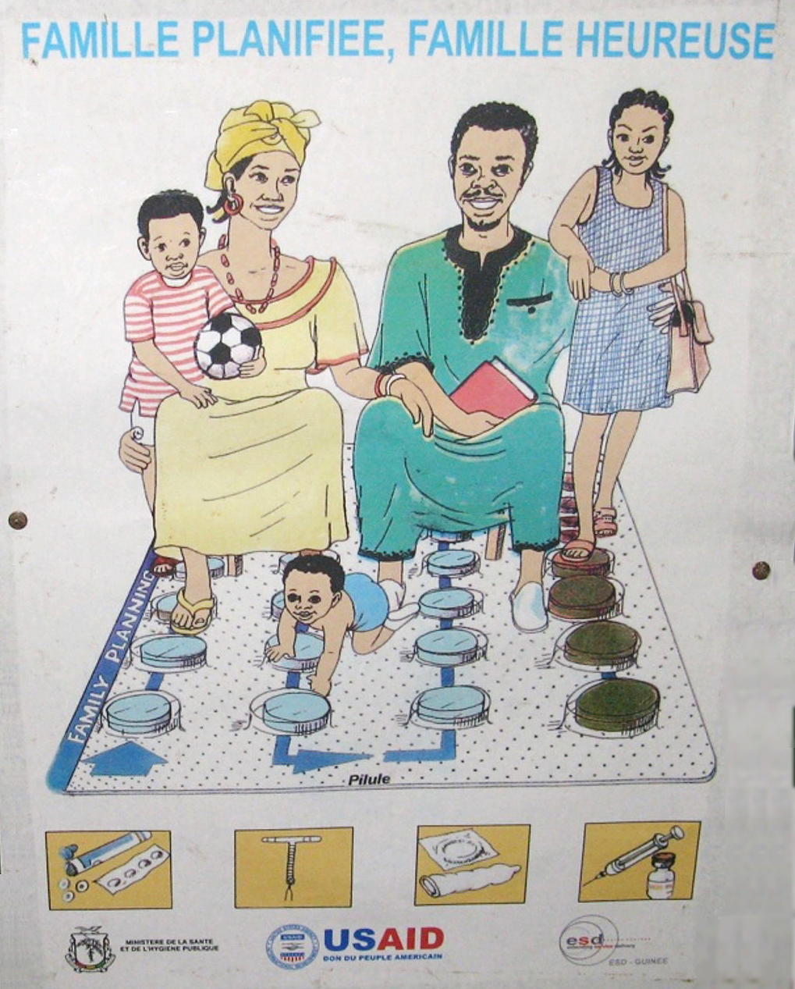
Support for quality: Patient health education
Patient health education posters/pamphlets are not considered job aids:
unless used by health workers providing health education or counselling
Example
A poster promoting family planning is not a job aid because the patient is usually the person who interprets the information.
© WHO
Notes:
Patient health education posters and pamphlets are not considered job aids unless they are expected to be used by health workers when providing health education or counseling.
Therefore, a poster promoting family planning is not a job aid because the patient is usually the person who interprets the information.

Slide 12

Support for quality: Training of staff
The questionnaire has questions related to training:
whether staff received related training in the past two years
structured training plans
programs led by a trainer/ qualified supervisor
Notes:
Throughout the questionnaire, there are questions related to whether staff, who provide a service, received related training in the past two years.
Training refers to structured training plans or programs led by a trainer or appropriately qualified supervisor.

Slide 13



Support for quality: Training of staff
on-the-job training is not accepted
in-service training (education for employees)
training takes place after staff member begins work
Notes:
Unless specified, on-the-job training is not accepted for the definition of trained staff.
Training refers to an in-service training, meaning education for employees to help them develop their skills in a specific discipline or occupation.
In-service training takes place after an individual begins work responsibilities.

Slide 14
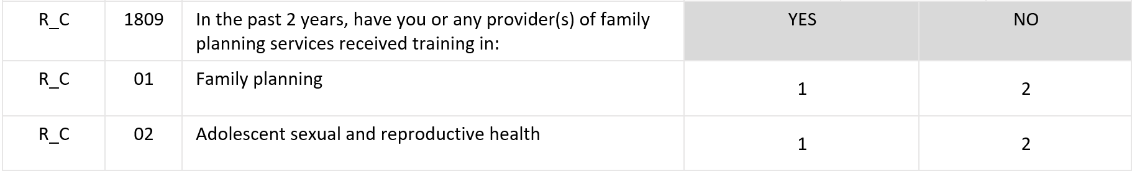
Support for quality: Training of staff
A single formal training related to a service may have covered several of the topics.
Notes:
If the respondent is not certain if a staff member providing the indicated services has received training in the past two years, ask to speak with someone who might know.
A single formal training related to a service may have covered several of the topics asked about.
There are two response options (“YES” or “NO”) based on the interview response from the in-charge of the service area.

Slide 15
You have now completed Unit 5.
Now try the practice exercises and the end of module quiz.
Notes:
You have now completed Unit 5.
Now try the practice exercises and the end of module quiz.

